Slide 1
Docker
Muralitharan R K

Slide 2
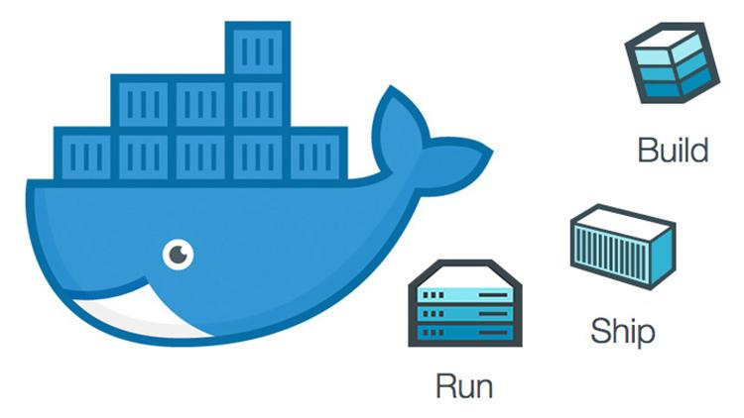

Slide 3
Overview
Docker Architecture
Docker images and containers
Docker networking
Docker Storage
Docker Compose
Docker Swarm

Slide 4
About Docker
Advantages
Docker is a tool designed to make it easier to create, deploy, and run applications by using containers. Containers include with all the application dependencies package.
Multiple containers can run on the same hardware.
High Productivity.
Maintain isolated environment.
Quick and easy deployment and configuration.
Can release application version quickly.
It has an important role play in the DevOps Concept.

Slide 5
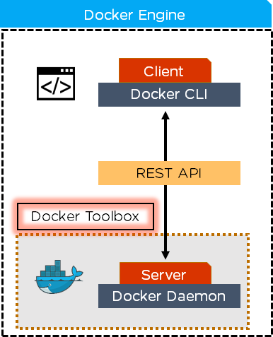
Docker Architecture
It works client and server architecture model
Docker CLI and Docker daemon can talk each other using Docker Rest API.
Docker registry store all docker images.

Slide 6
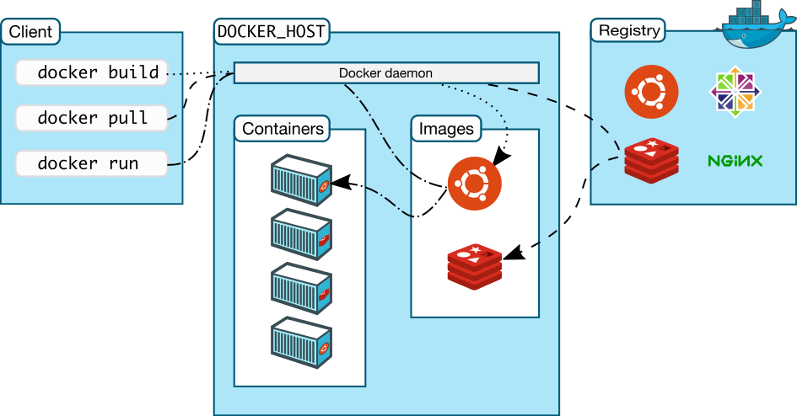

Slide 7
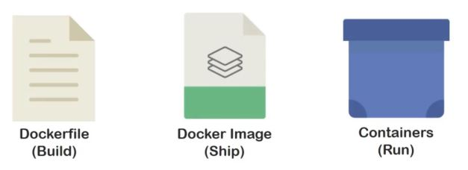
Docker images and containers

Slide 8
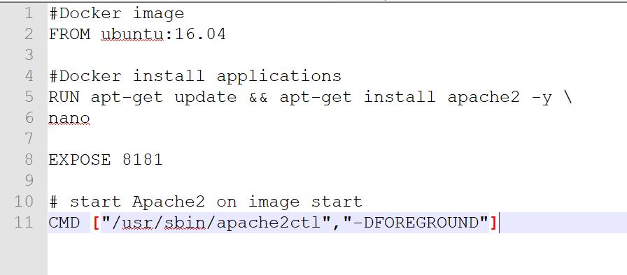
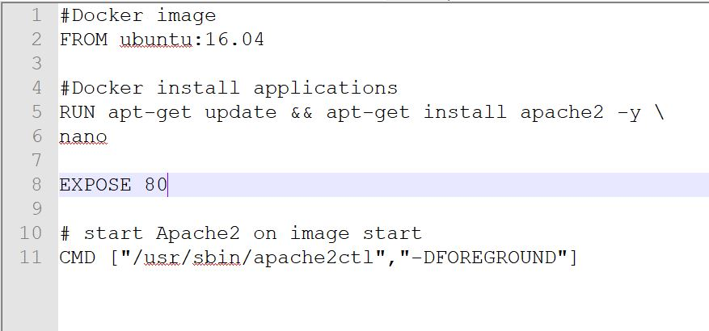
Dockerfile

Slide 9
Docker containers

Slide 10
Docker Networking

Slide 11
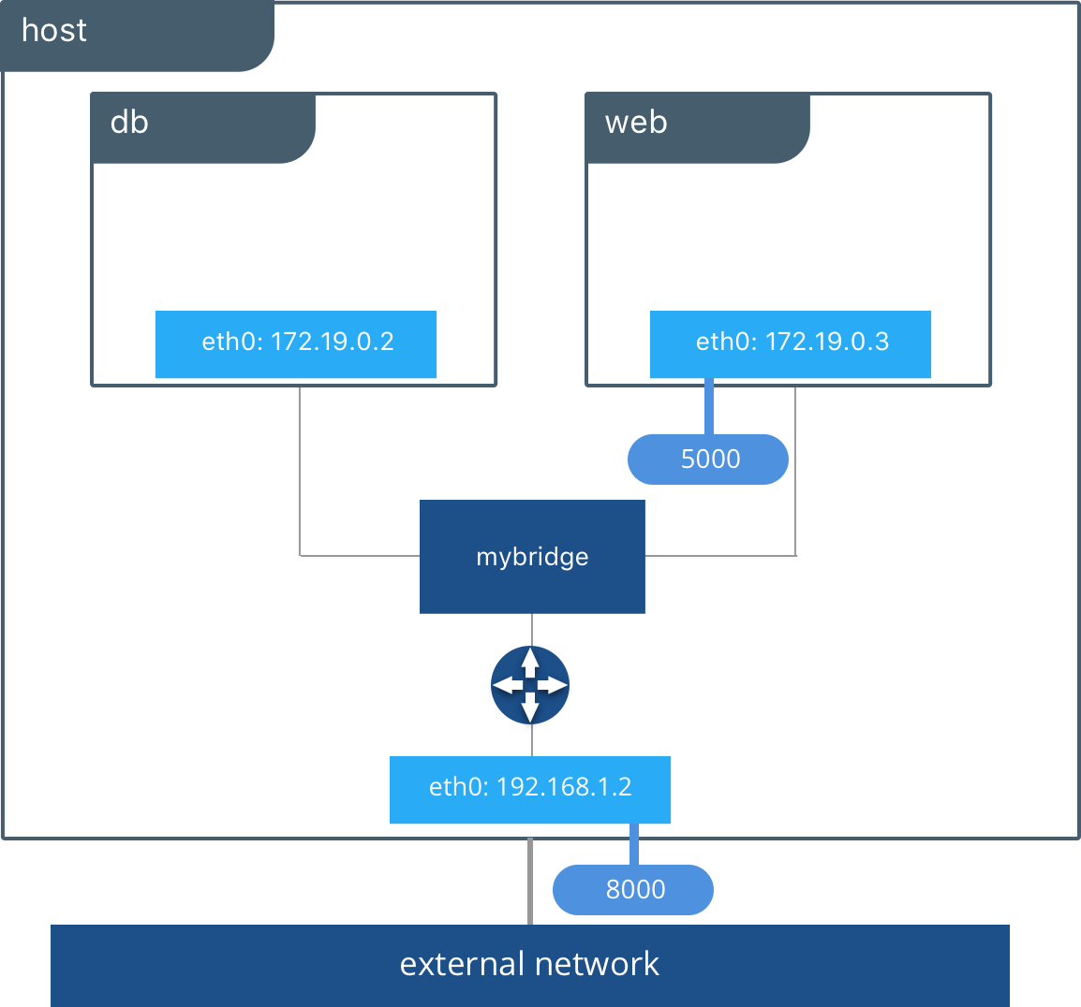
Docker Networking
Docker network is used to communicate between the host machine and docker containers.
Host Network
Bridge Network
Overlay Network
None Network

Slide 12
CONT - 1
CONT - 2
CONT - 3
CONT - 4
CONT - 5
CONT - 6
CONT - 7
CONT - 8
CONT - 9
CONT - 10
External Network

Slide 13
CONT - 1
CONT - 2
CONT - 3
CONT - 4
CONT - 5
CONT - 6
CONT - 7
CONT - 8
CONT - 9
CONT - 10
External Network

Slide 14
CONT - 1
CONT - 2
CONT - 3
CONT - 4
CONT - 5
CONT - 6
CONT - 7
CONT - 8
CONT - 9
CONT - 10
External Network

Slide 15
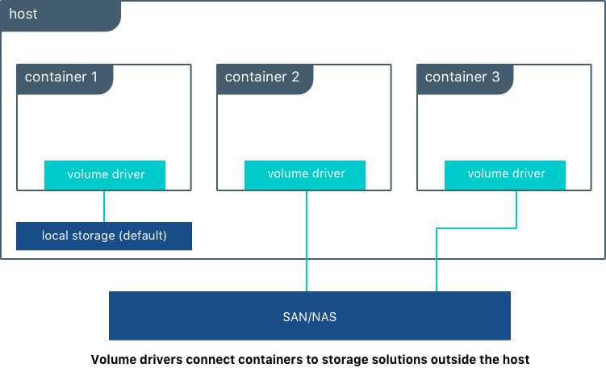
Docker Storage
Docker allow us to mount external storage into our docker containers. Which will help us to maintain our applications with high availability.
If some reason docker container get crashed, we can’t get data from container. So that we use mount the data to external storage.

Slide 16
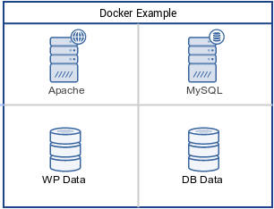
Docker Compose
Docker compose is used to run a multiple containers as a single service.
Like if we run apache in one container and mysql run in another container. We can run those containers as a single service using docker compose.

Slide 17
Docker Swarm:

